Slide 1

Binary Classification

Slide 2
Assignment 2 Notes
Make sure you are reading previous week comments
The model isn’t the problem, the problem is the business car
Don’t just retell the results, tell a story
The focus should always come back to the business problem, nobody cares in the end how good the model is.

Slide 3
Exercise
Question: What makes a good Chicken Parmesan vs. a bad one
Analysis:
- Sauce, heat, chicken thickness, pasta shape
Answer This: You are going to add Chicken Parmesan to your menu, how are you going to use the analysis above to make the best Chicken Parm in the city.
10 mins
Group of 5
Make a recipe of how to make the best Chicken Parm
Give me the order of cooking
Give me how much time each step should take
On each step I want to know the quality/importance of getting each step correct

Slide 4

Classification Problems
Classification Problems are the most common type of Predictive Analytics
Binary -> Yes or No
Multi Case -> Color Of Car
This week we will tackle ways to evaluate a….
Binary Classification Problem

Slide 5
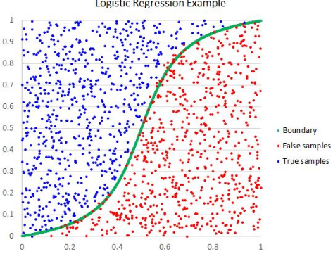
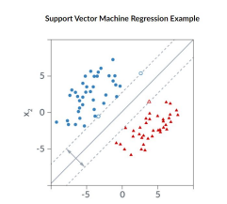
Two Key Approaches
The Two Approaches We Will Look At Are
Logistic Regression
SVM

Slide 6

Logistic Regression
Logistic regression is one of the most well known models in machine learning when it comes to classification (binary only). Examples of use cases of logistic regression are:
To readmit or not
To buy or not
To play or not
To use a logistic regression model, you need to be predicting a dependent variable that is binary. You can use multiple discrete or continuous variables in the model (independent), but you have to use a binary dependent variable (0 or 1)
As you can see in the image below, a linear regression model produces a line (y=mx+b), ,which is how your output will be structured as well.
Key To Remember Is That The Problem Is Linear

Slide 7
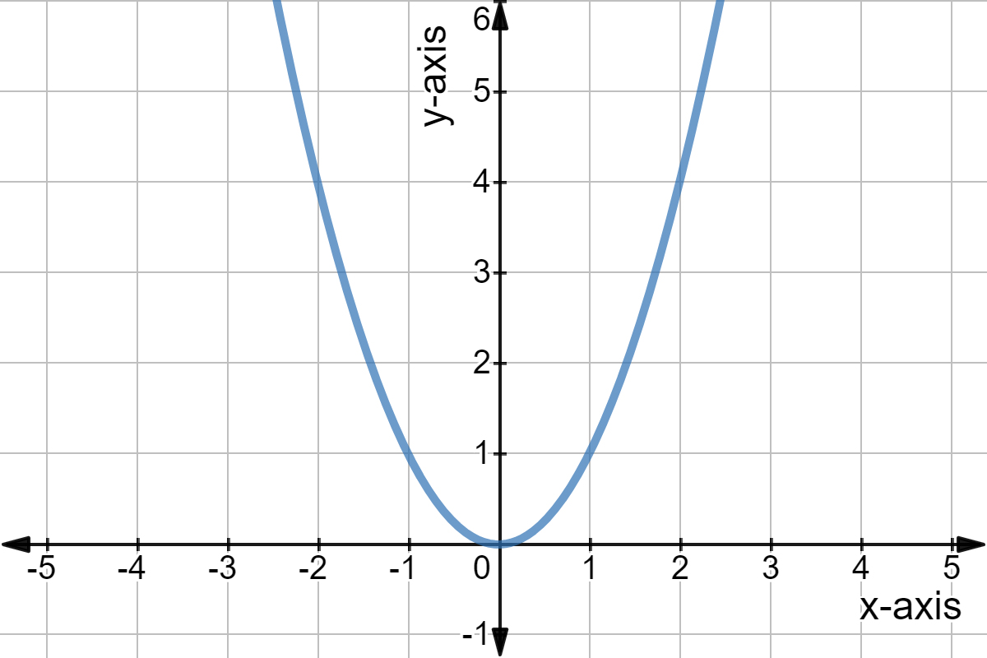
SVM
SVM is a much less commonly used Binary Classification technique but can help us potentially optimize our problem. This model uses a Hinge Loss Function to classify data points.
Data point is place based on accuracy instead of the output
Logistic Regression, our data point is just put on what the output value is (.6 or .8)
Hinge Loss will be placed on how far it is off from the prediction
If the predicted value is +.6 and the actual is +1 then it is classified as .4.
Key Difference Between Logistic In SVM
Logistic Regression Output is 0 or 1. Controlled by threshold value
SVM is -1,0,1. Algorithmic (Hinge function)
But Professor, I thought you said this is Binary….

Slide 8
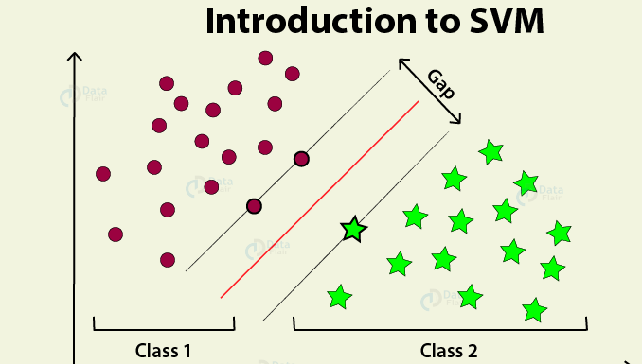
SVM Output
The classifications come from the hyperplane and how it divides the points. As we can see here we have two classes and points on the line (within the gap). The +1 and -1, don’t really make a difference but those with a 0 are unclassified and lost from our dataset

Slide 9
SVM Vs Logistic Regression
How do we compare and contrast the models…
Compare:
Final usable data, splits data into two categories
Both use a linking function to separate classes
Both crucial to look at accuracy and confusion matrix (get to later)
Contrast:
Logistic Regression is for linear problems, SVM can be non linear
Logistic Regression can adjust classifications, SVM you cannot
Logistic Regression get nice clean outputs (variables), whereas SVM is more for optimizing models

Slide 10
Logistic Regression: Interpretation
The equation for a logistic regression model looks similar to the following: Likelihood of Diabetes=20+ .01(hgt)
What we see here is an example of a logistic regression model with one (you can have many and you should) independent variable (hgt or height) and the dependent variable (Likelihood of Diabeters). We would the interpret the following equation like this:
For every additional inch increase in height, on average that would make you .01 % more likely to have diabetes.
Just like linear regression, we can use an interpretation like this to find business value from this model.
.

Slide 11
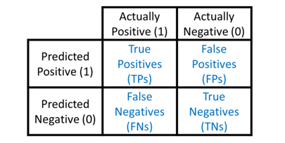
Logistic Regression In Python
To run a logistic regression model, the steps will be similar to that of the linear regression model, except for one extra step at the end.
Separate the independent variables and dependent variable into separate data frames
Create the constant (y-intercept)
Run Model
Build confusion matrix to calculate accuracy
Since there is not a R-squared value for a logistic regression model, we have to calculate it on our own. To do this we build a confusion matrix that allows us to see how well our predictions are doing (True Positives vs False Positives and so on). An example of a confusion matrix is below to jog your memory.
For this model we will be trying to predict the variable, US Made.

Slide 12
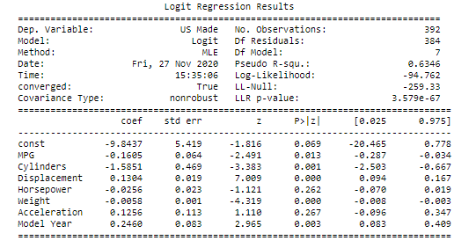
Logistic Regression Code Result
From the linear regression model, we know what the key variables are but we had to check to see how accurate this model is. To do this, it will be easier if we use the Sklearn package here that was referenced earlier by building the confusion matrix and calculating the accuracy.

Slide 13
Logistic Regression Code Walk Through
Separate the independent variables and dependent variable into separate data frames (use cleaned data frame)
y_logr=CarsHP[['US Made']]
x_logr=CarsHP.drop(['US Made'],axis=1)
Create the constant
Xlog2 = sm.add_constant(x_lr)
add_constant is part of statsmodel.api
3. Run Model
Xlog2 = sm.add_constant(x_logr)
logr_model = sm.Logit(y_logr, Xlog2) -> Using Logit instead of OLS since it is logistic regression
logr_fit = logr_model.fit()
print(logr_fit.summary())

Slide 14

Logistic Regression Code - Results
Using Sklearn and statsmodels.api yield the same results, but just for simplicity, we will rebuild the model in Sklearn to get the other results that we need.
Build Confusion Matrix
from sklearn.linear_model import LogisticRegression
from sklearn.metrics import classification_report, confusion_matrix
logistic_regression= LogisticRegression()
model=logistic_regression.fit(x_logr,y_logr)
confusion_matrix(y_logr, logistic_regression.predict(x_logr))
2. Accuracy
model.score(x_logr, y_logr)

Slide 15
SVM Code In Canvas
Focus just on accuracy and benchmarking metrics. See if Logistic Regression model results change when you move to SVM model.

